Slide 1
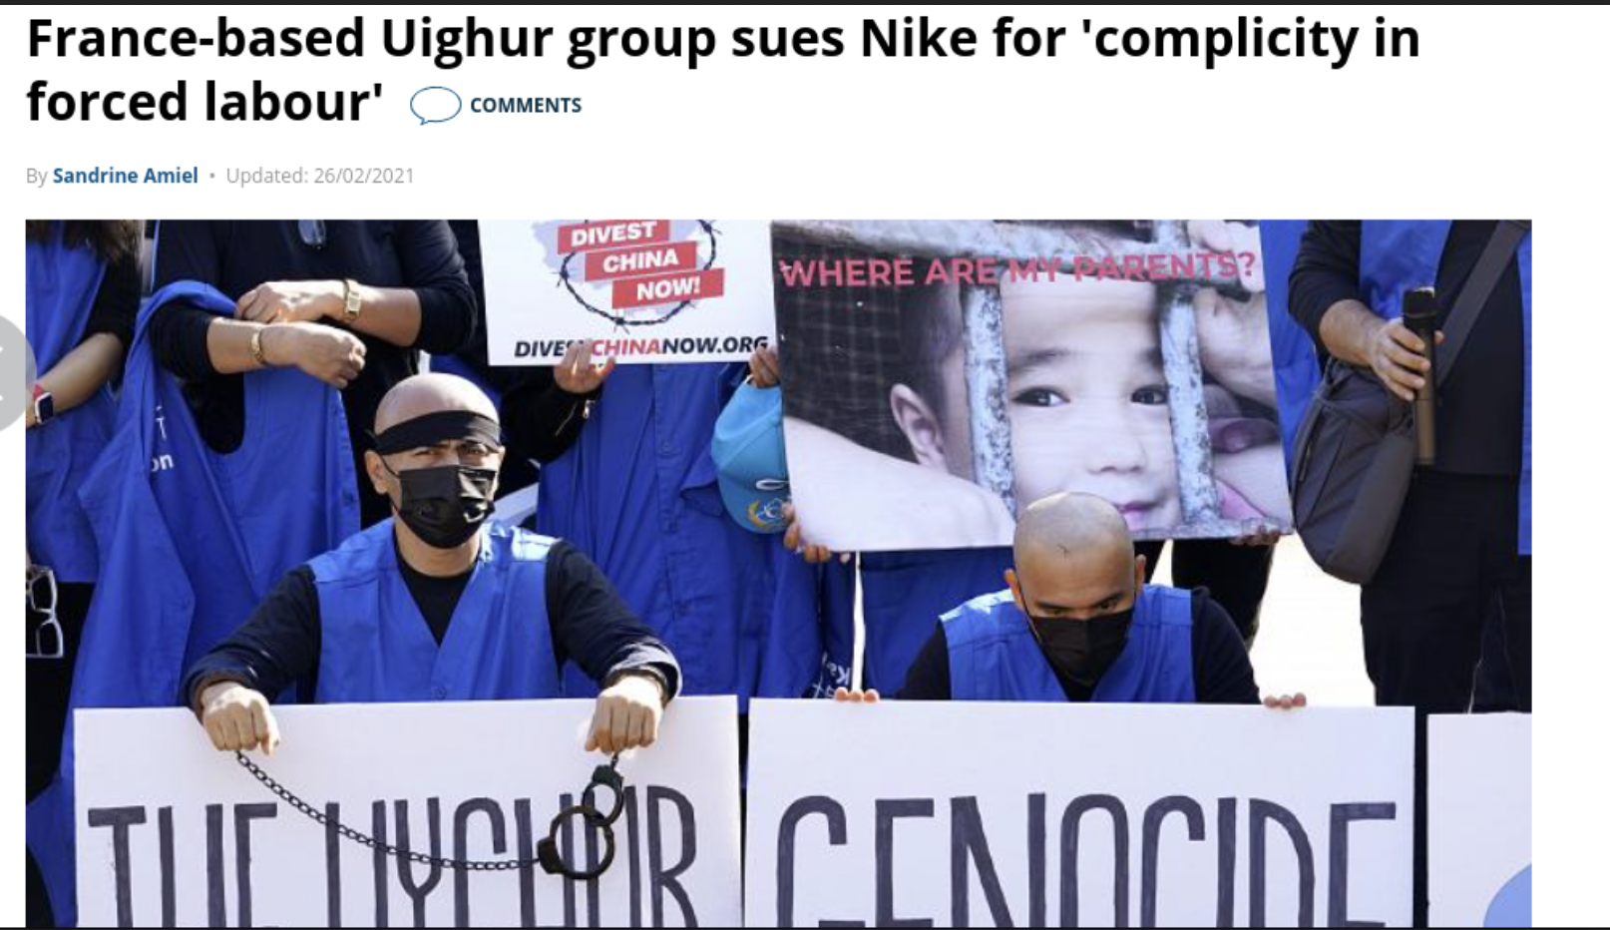
France-based Uighur group sues Nike for ‘complicity in forced labour’
https://www.euronews.com/2021/02/26/france-based-uighur-group-sues-nike-for-complicity-in-forced-labour

Slide 2
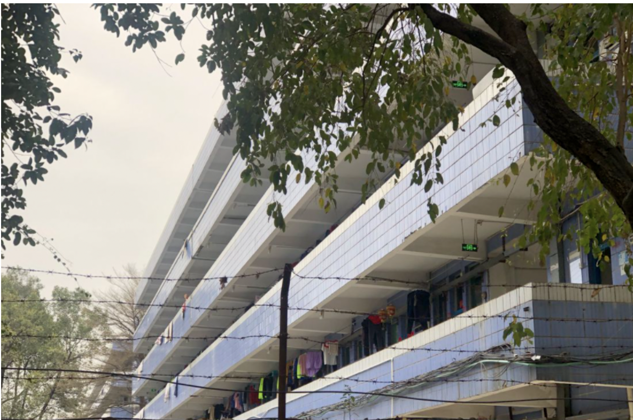
Thousands of Uyghur workers in China are being relocated in an effort to assimilate Muslims, documents show
https://www.theglobeandmail.com/world/article-thousands-of-uyghur-workers-in-china-are-being-relocated-in-an-effort/

